Slide 1
Free sound audio tagging
Aihua Chen, Andres HERRERA, GLEN DINOlfo and ramneek bali

Slide 2
The model was trained and run on aws server
Free sound General-Purpose Audio Tagging Challenge - 2018
Can you automatically recognize sounds from a wide range of real-world environments? Single label
9500 Sample files (.wav)
3700 Sample files manually verified
"Acoustic_guitar", "Applause", "Bark", "Bass_drum", "Burping_or_eructation", "Bus", "Cello", "Chime", "Clarinet", "Computer_keyboard", "Cough", "Cowbell", "Double_bass", "Drawer_open_or_close", "Electric_piano", "Fart", "Finger_snapping", "Fireworks", "Flute", "Glockenspiel", "Gong", "Gunshot_or_gunfire", "Harmonica", "Hi-hat", "Keys_jangling", "Knock", "Laughter", "Meow", "Microwave_oven", "Oboe", "Saxophone", "Scissors", "Shatter", "Snare_drum", "Squeak", "Tambourine", "Tearing", "Telephone", "Trumpet", "Violin_or_fiddle", "Writing"
Extraction of features is a very important part in analyzing and finding relations between different sounds
Notes:
Extraction of features is a very important part in analyzing and finding relations between different things. The data provided of audio cannot be understood by the models directly to convert them into an understandable format feature extraction is used. It is a process that explains most of the data but in an understandable way. Feature extraction is required for classification, prediction and recommendation algorithms.
In this blog, we will extract features of music files that will help us to classify music files into different genres or to recommend music based on your favorites. We will learn different techniques used for extracting features of music.
The audio signal is a three-dimensional signal in which three axes represent time, amplitude and frequency.

Slide 3
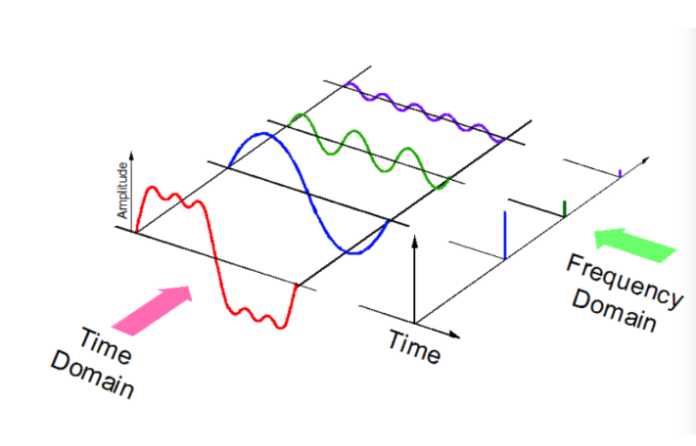
audio signal can be expressed as a function of Amplitude and Time
Notes:
Somehow, we must extract the characteristics of our audio signal that are most relevant to the problem we are trying to solve. For example, if we want to classify instruments by timbre, we will want features that distinguish sounds by their timbre and not their pitch. If we want to perform pitch detection, we want features that distinguish pitch and not timbre.
This process is known as feature extraction.
The physical characteristics of sound that determine the perception of timbre include spectrum and envelope

Slide 4
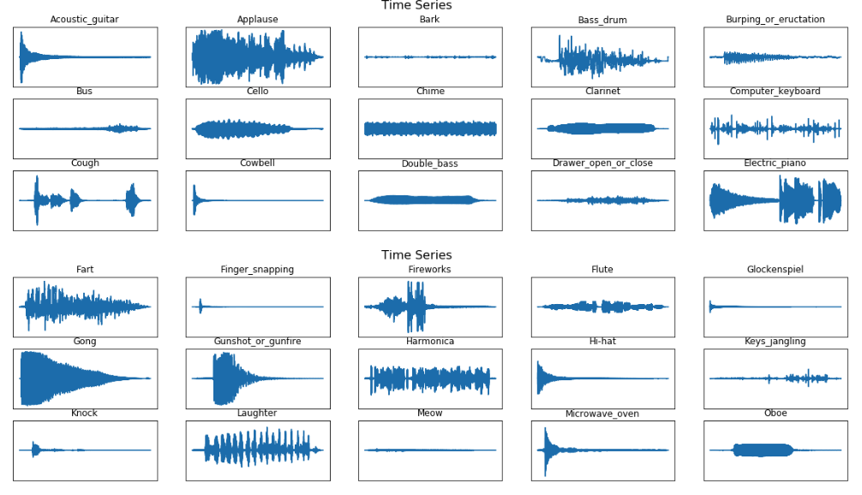
Extract the features – Amplitude envelope of a waveform
Notes:
Somehow, we must extract the characteristics of our audio signal that are most relevant to the problem we are trying to solve. For example, if we want to classify instruments by timbre, we will want features that distinguish sounds by their timbre and not their pitch. If we want to perform pitch detection, we want features that distinguish pitch and not timbre.
This process is known as feature extraction.
The physical characteristics of sound that determine the perception of timbre include spectrum and envelope
librosa.display is used to display the audio files in different formats such as wave plot, spectrogram, or colormap. Waveplots let us know the loudness of the audio at a given time. Spectogram shows different frequencies playing at a particular time along with it’s amplitude. Amplitude and frequency are important parameters of the sound and are unique for each audio.

Slide 5
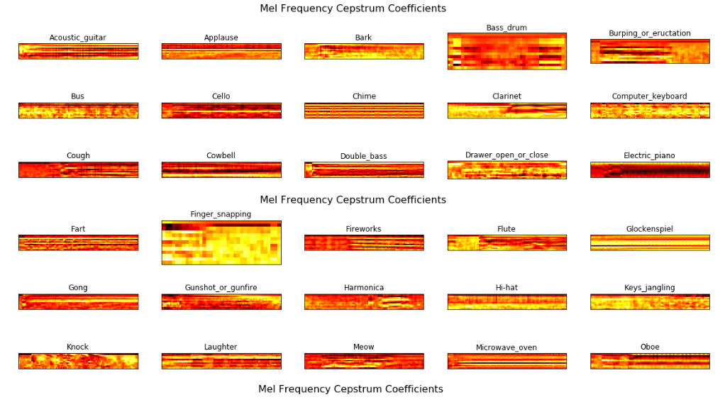
Mel frequency cepstrum coefficients

Slide 6
Libraries used
import os
import glob
import numpy as np
from tqdm import tqdm
import librosa
import pandas as pd
from sklearn.utils import shuffle
from keras.utils import np_utils
import time
from keras.models import Model
from keras.layers import Conv1D, MaxPooling1D, Input, Conv2D, MaxPooling2D
from keras.models import Sequential
from keras.layers import Dense, Bidirectional, LSTM, BatchNormalization, Dropout, Flatten, Embedding
from keras.optimizers import SGD
from sklearn.metrics import confusion_matrix

